Slide 1
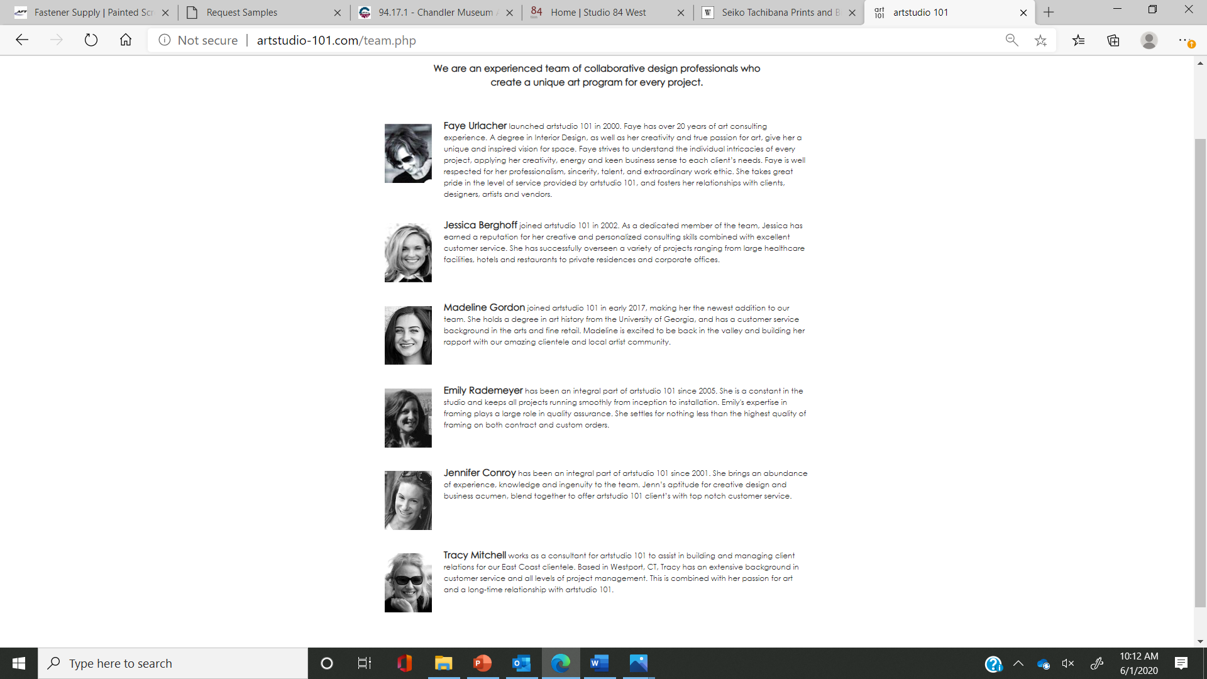

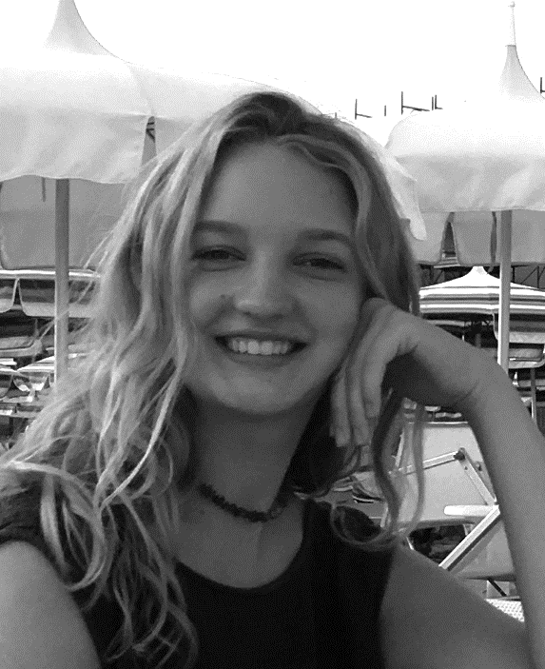
*Original
*New
Faye Urlacher launched artstudio 101 in 2000. Faye has over 20 years of art consulting experience. A degree in Interior Design, as well as her creativity and true passion for art, give her a unique and inspired vision for space. Faye strives to understand the individual intricacies of every project, applying her creativity, energy and keen business sense to each client’s needs. Faye is well respected for her professionalism, sincerity, talent, and extraordinary work ethic. She takes great pride in the level of service provided by artstudio 101, and fosters her relationships with clients, designers, artists and vendors.
Emily Rademeyer joined in as a project manager in 2005. She keeps all projects running smoothly from inception to installation. Emily's expertise plays a large role in quality assurance. Her level of organization and detail keeps all projects on track.
Jennifer Conroy has been an integral part of artstudio 101 since 2001. She brings an abundance of experience, knowledge and ingenuity to the team. Jenn’s aptitude for creative design and business acumen, blend together to offer artstudio 101 client’s with top notch customer service.
Sophia Niskanen is the newest member of artstudio’s team, and we are so excited to have her on board. She is always looking for what is fresh and new on the art scene. Her attitude and creativity means that your project will be expertly handled.

